Slide 1
Inclusion of Persons with Disabilities in MSF
Kit for awareness raising
Organized by:
The TIC project on Inclusion of Persons with Disabilities in MSF
Contact: patrice.vastel@oslo.msf.org August 2018

Slide 2
INTRODUCTION
VIDEO
QUESTIONS & DISCUSSION
LEARN MORE
SHARE & FEEDBACKS

Slide 3
Introduction - Definition
“Persons with disabilities include those who have long-term physical, mental, intellectual or sensory impairments which in interaction with various barriers may hinder their full and effective participation in society on an equal basis with others.”
(UN Convention on the Rights of Persons with Disabilities)
Notes:
Definition is opened

Slide 4
Introduction - Background
Different steps taken so far in MSF on inclusion of persons with disabilities:
The 2016 IGA Motion on inclusion of persons with disabilities (PWDs)
The 2018-2019 TIC project on Inclusion of PWDs and its portal
The April-May 2018 perception survey on inclusion of PWDs in our missions run by the TIC project

Slide 5
Introduction - Background
2016 Motion on inclusion of persons with disabilities in MSF
Recognizing that persons with disabilities are often the most in need in regions where MSF works and that their exclusion may hamper our humanitarian identity and impartiality, MSF should:
Initiate actions to develop its awareness on this risk of exclusion of persons with disabilities,
Develop dialogue with organizations of persons with disabilities where/when possible,
Take in account accessibility to persons with disabilities of our facilities and of our communication materials.

Slide 6
Introduction - Background
Results Voting 2016 – Motion on inclusion of persons with disabilities in MSF
 | In favor | Against | Abstention
IGA 2016 | 39 | 1 | 2
OCB Gathering 2016 | 272 | 13 | 44
MSF Nordic GA 2016 | 137 | 7 | 6

Slide 7
Introduction - Background
The TIC* project on inclusion of persons with disabilities (1.1.2018-30.06.2019)
Meant to facilitate the implementation of the motion
Vision to “transform MSF into an organization more inclusive of persons with disabilities in its structure and action”.
This project is developing, gathering and promoting materials of relevance to raise awareness on what barriers persons with disabilities are facing and how to practically become more inclusive of persons with disabilities in our organization and missions.
All key materials are gathered in a single portal: http://disabilityinclusion.msf.org/
This project run also a perception survey on inclusion of PWDs in our mission towards the national and international staff in the overall MSF movement in April-May 2018.
TIC (Transformational Investment capacity): a newly established committee in MSF to promote transformation of the organization to better respond to the challenges of today and tomorrow. http://msf-transformation.org/

Slide 8
Introduction - Background
Some conclusions from the survey (April-may 2018)
Target group: national and international staff in mission in 2015-2017; 239 responses.
About 60% of MSF international staff and 80% of MSF national staff believes more should have been done when it comes to inclusion in their last assignment.
Small actions can make a difference
More discussions should have taken place in the missions

Slide 9
Video
Why is it important for MSF to develop awareness on inclusion of PWDs?
And How to be more inclusive?
https://youtu.be/i4VerdEEOLo

Slide 10
Questions and discussion
What arguments are often raised against efforts to be more inclusive?
What are the counter-arguments and what do you think?
What can be done?
What will you do practically?
Send us comments, ideas, feedbacks on this kit
You want to know more : http://disabilityinclusion.msf.org

Slide 11
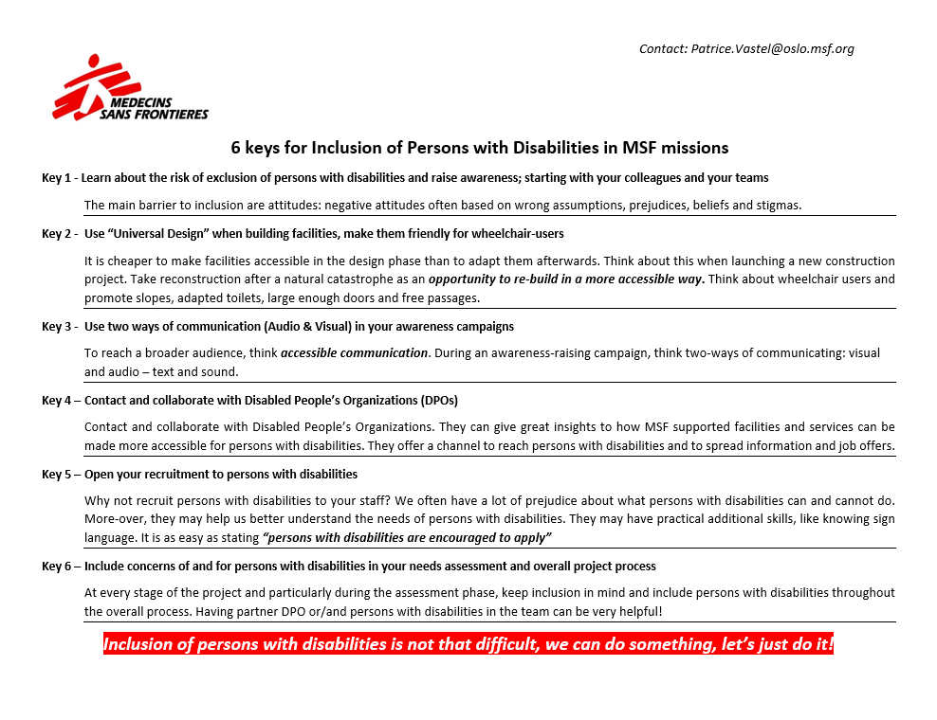

Slide 12
Thank you
Thanks
Inputs, Questions, Comments Portal
patrice.vastel@oslo.msf.org http://disabilityinclusion.msf.org

Slide 13
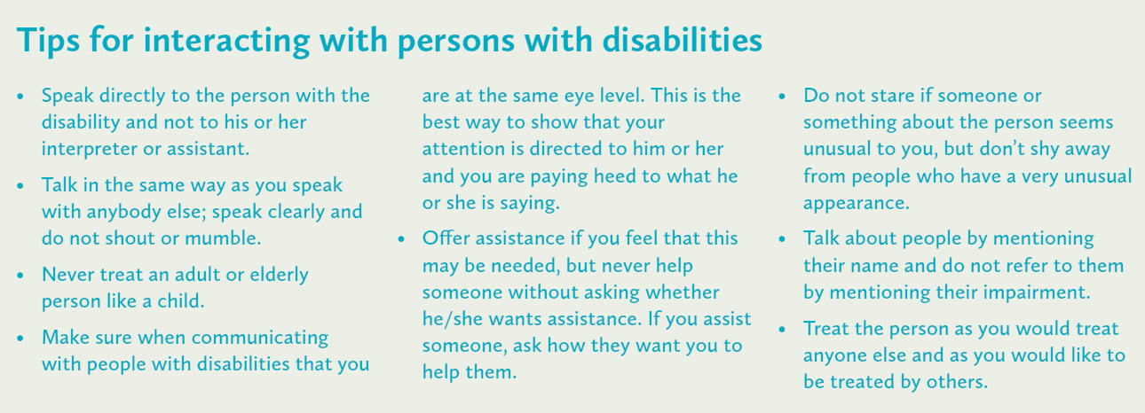
Tips
Source: «Count me in», Light for the world, p.35

Slide 14
Tips
Colleague with hearing impairment - What can you do as a colleague?
Catch your colleague's attention before speaking
Watch your colleague when you speak. Do not stand with your back to him or talk from another room
Speak clearly and not too fast
Give written notes about important things
Substantiate what you say with body language and facial expressions
Repeat several times, reformulate or write down if you see that your colleague has not understood what you are saying
Be patient. Do not say "forget it" or show irritation if you have to repeat many times. One who is hearing impaired uses a lot of energy to hear what is being said, give him or her a chance to get involved.“
https://www.hlf.no/horsel/yrkesaktiv-og-horselshemmet/

